Slide 1





STUDENT MANAGEMENT SYSTEM
Team Members:
M MONIKA
KANNALI MEGHANA REDDY
EMURU CHANDHINI
SUPRIYA CHINTHALA Guide: UMA MAHESWARI R
Disclaimer: The content is curated for educational purposes only.

Slide 2
OUTLINE
Abstract
Problem Statement
Aims, Objective & Proposed System/Solution
System Design/Architecture
System Development Approach (Technology Used)
Algorithm & Deployment
Conclusion
Future Scope
Output Screens
References
Video of the Project
Notes:
These are the list of chapters that we are going to cover in these foundation codes. Those are chapter one what are AI and ML? chapter 2 applied Python programming in AI, and chapter 3 is exploratory data analysis for ML.

Slide 3
Abstract
Student Management System is a management of information system for education establishments to manage student data.
The Student Management System is an automated version of manual Student Management System.
Student Management System is software which is helpful for students as well as the college authorities. In the current system all the activities are done manually. It is very time consuming and costly. Our Student Management System deals with the various activities related to the students.
Student Management System can handle all the details about a student. The details include college details, Students personal details, Academic details etc.
It provides capabilities for registering students in courses, admitting students, tracking student attendance and submitting students documents and fee payment online.

Slide 4
Problem Statement
The educational institutions has to handle records for many number of students and maintaining more number of student records is very difficult. Using manual system to manage the students details in the form of physical records causes the loss of data and prone to unauthorized access. It becomes difficult and troublesome to handle data. This project addresses these issues by developing a Student Management System which is useful for educational institutions.

Slide 5
Aim and Objective
Aim:
The aim of the Student Management System project is to provide a centralized, efficient and advanced platform for managing various aspects of students related information and administrative tasks within an educational institution.
Objective:
The objective of the Student Management System is to enhance the efficiency, and overall effectiveness of educational administration within a institution, focusing on key features such as
To manage students information during admission and examination.
To reduce unnecessary paper work in maintaining students information.
To foster transparent and efficient communication.
Provide real-time monitoring of student performance.

Slide 6
Proposed Solution
Existing System:
The existing system operates manually, which maintains physical records to store student details such as student name, email, phone number, personal details, marks etc. This manual process makes it challenging to manage historical data effectively.
Disadvantages:
There are several drawbacks of the existing system such as:
Searching and upgrading the details is tedious task.
Inadequate security measures.
As the number of students increases, it leads to performance issues.
Proposed System:
The proposed system is student management system designed to overcome the limitations of the existing system. The student management system allows authorized members to access the records of academically registered students and simplifies the work of the institutes.
The application helps in maintaining the database of students in any educational organization. We can easily access any students information at anytime and can be kept securely for long period of time without any damage.

Slide 7
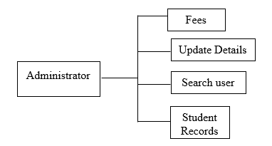
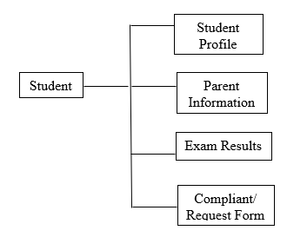
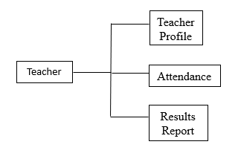
System Architecture

Slide 8
System Deployment Approach
Hardware Requirements:
Processor: Pentium
RAM : 256 MB
Hard Disk: 10 GB
Microsoft Compatible Keyboard
Software Requirements:
Operating System : Windows
Web Technologies: PHP
Front-End: HTML, CSS, JavaScript
Back-End: PHP, MySQL
Web Server: Apache Server

Slide 9
Algorithm & Deployment
Algorithm: Authenticate Admin User
Input:
- $_POST[‘u name']: User's email or username
- $_POST['password']: User's password
- $ref: The referring page URL
Output: Redirect to dashboard or back to referring page with appropriate message
1. Include the database connection script 'dbConnection.php'.
2. Retrieve user input:
- Get the value of 'uname' (username/email) from the HTTP POST request.
- Get the value of 'password' from the HTTP POST request.
3. Sanitize user input:
- Remove any potentially harmful characters from 'uname' and 'password' to prevent SQL injection attacks.

Slide 10
4. Execute a database query:
- Perform a SQL SELECT query to check if there is a record in the 'admin' table where the email and password match the provided values.
5. Process the query result:
a. If the query returns exactly one matching record:
- Start a session.
- Set session variables:
- $_SESSION["name"] = 'Admin'
- $_SESSION["key"] = ‘Admin@123'
- $_SESSION["email"] = $email
- Redirect the user to the dashboard page 'dash.php?q=0' with a success message.
b. If no matching record is found:
- Redirect the user back to the referring page '$ref' with a warning message.
End Algorithm

Slide 11
Deployment Steps:
Database set up:
Create a database with a table named administration containing fields like username and password.
Environment Configuration:
Ensure that environment supports PHP and SQL and adjust environment settings, including database connection, API keys.
Server Configuration:
Configure the server environment, ensuring that the server meets the necessary hardware and software requirements. Install and configure necessary web servers.
Security Measures:
Implement security best practices to protect stored data from intrusion attacks and ensure compliance.
Testing:
Conduct load testing to assess the system’s performance under various levels of user traffic.
Create Database connection:
Create PHP script responsible for establishing a connection to the database.
Deploy PHP Script:
Deploy the PHP script which contains the PHP code on web server.
Monitor and Maintain:
Regularly track the application performance to detect errors and troubleshoot issues.
Maintain latest software so that the application will not get outdated.

Slide 12
Conclusion
Student Management System project is designed to overcome the problems faced by the educational institutions
Easy to handle and feasible so all educational institutions can use this frequently.
Improved operational efficiency by automating administrative tasks.
Improved data management.
System security, data integrity and reliability.
Adaptability and Scalability.
Security and Compliance.
Cost Reduction.
Fast and Convenient.

Slide 13
Future Scope
Student Management System can involve several enhancements and advancements to meet evolving educational needs.
Future Enhancements:
Integration with Learning Management Systems
Advanced Analytics and Predictive Insights
Enhanced Communication Channels
Mobile Compatibility
Personalized Learning Paths
Enhanced Security Features

Slide 14
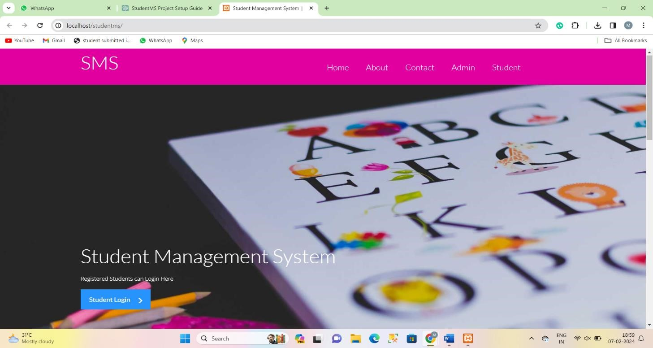
Output Screens

Slide 15
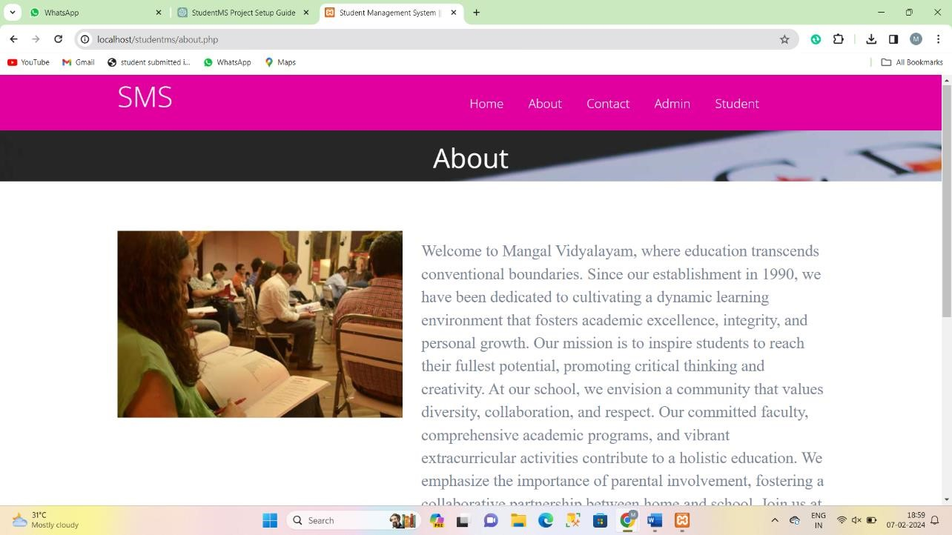

Slide 16
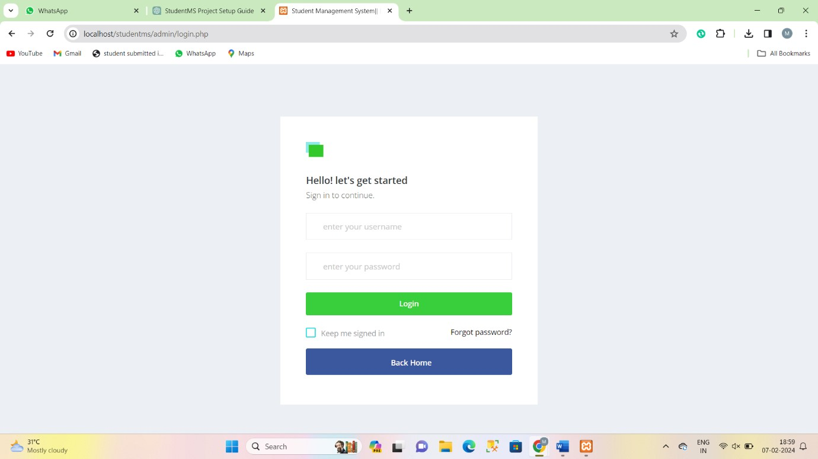

Slide 17
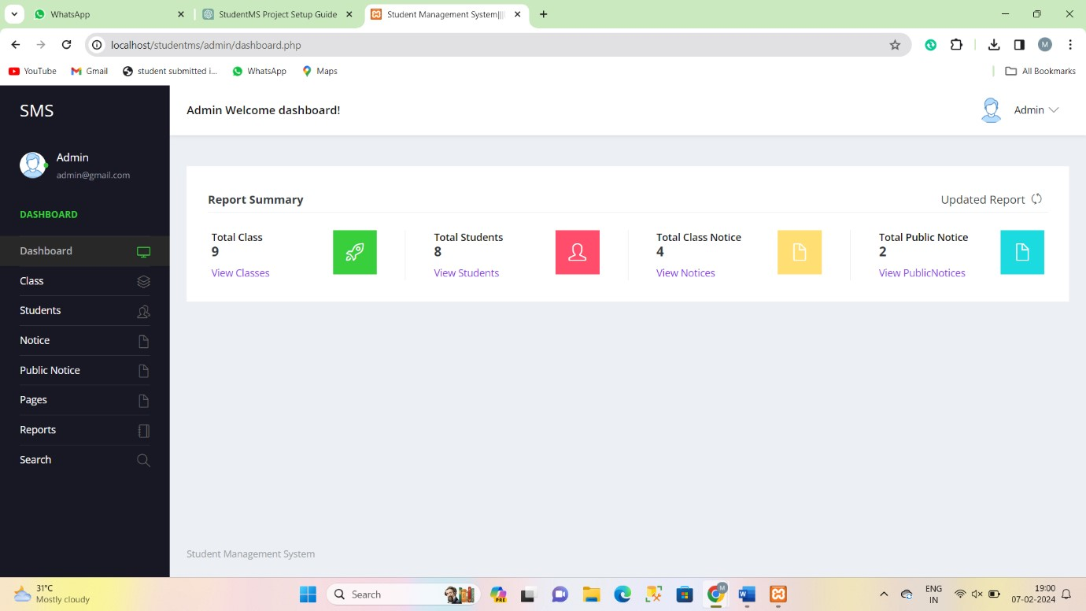

Slide 18
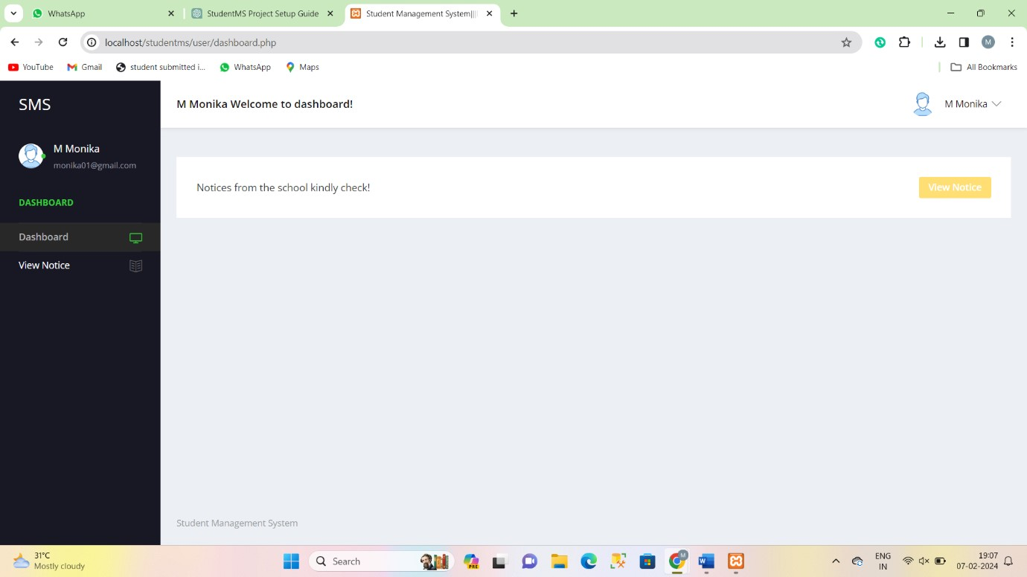

Slide 19
References
https://www.lovelycoding.org/student-management-system/
Notes:
Reference
These are the references for this session.
19

Slide 20
Video of the Project
https://drive.google.com/file/d/1uMf8_iFLy8BVsiBxHtDYleriqQqtf_JR/view?usp=drive
Notes:
Reference
These are the references for this session.
20

Slide 21
Thank you!
Notes:
thank you very much for joining this PPT, keep learning.
21

